Slide 1
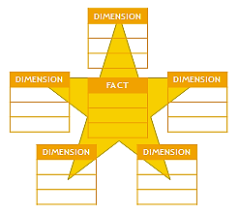
Dimensional Modelling for Data Warehouses
Topic 02 - Part 2

Slide 2
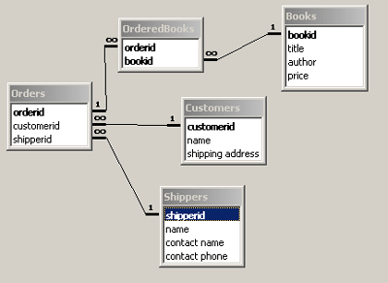
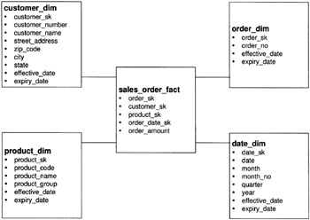
Recap
Introduction
In Topic 2, you learnt that building a data warehouse requires the integration of data from different transactional systems
Data in a data warehouse is stored differently from data in a transactional system
Data warehouses use the Dimensional model while transactional systems use the Entity-Relation (ER) model to store data
ER model
Dimensional model

Slide 3
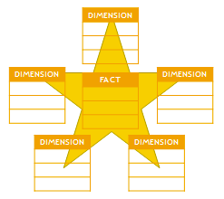
Recap
Introduction
In this topic, you will learn:
Why data warehouses need a different way to store data compared to transactional systems
What is the Dimensional model and why it is suitable to be used in a data warehouse
How to create a dimensional data model using the Star schema and Snowflake schema

Slide 4
Contents
OLTP vs OLAP requirements
Dimensional Modelling
Compare ER Model and Dimensional Model
Star Schema
Fact Tables
Dimension Tables
Snowflake Schema
Dimension Hierarchies
Steps in designing a Dimensional Model

Slide 5
Data Warehouses store data differently
Data Warehouses vs Transactional Databases
Data in data warehouses is stored differently from data in transactional databases because they have different requirements
Transactional databases 3NF Entity-Relationship Model
Data Warehouse
Denormalized Dimensional Model

Slide 6
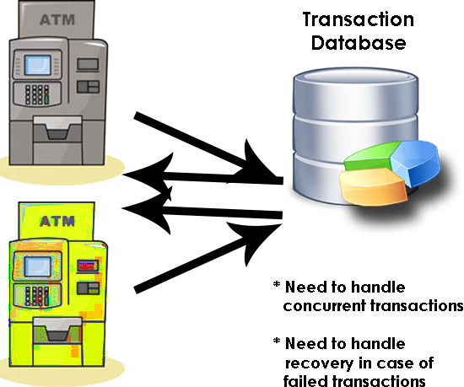
Requirements of Transactional DB
Data Warehouses vs Transactional Databases
Transactional databases are modelled to handle the requirements of Online Transactional processing (OLTP) systems
Examples of OLTP systems: ATM Machine or a POS (Point-Of-Sales) at a supermarket or e-commerce ordering system
An important requirement for OLTP databases is that it should maintain the integrity of data in such systems and provide recovery mechanisms

Slide 7
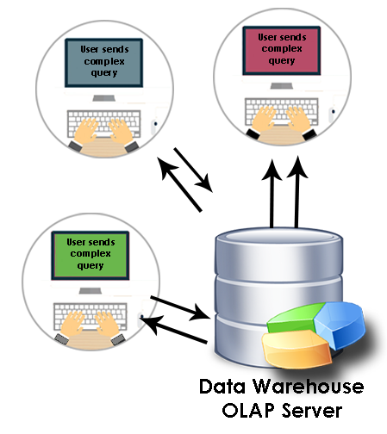
Requirements of Data Warehouse DB
Data Warehouses vs Transactional Databases
Date warehouse databases are modelled to handle the requirements of Online Analytical Processing (OLAP)
OLAP tools are used by business users to raise complex queries about their business data
An important requirement for OLAP databases is the ability to handle complex queries with high performance

Slide 8
OLTP (On-line Transaction Processing)
Data Warehouse vs Transactional Database
OLTP (On-line Transaction Processing) systems are designed to:
capture and store data related to day-to-day business functions such as ERP, CRM, SCM, POS,
Increase the efficiency of an organization
Characteristics:
Involve a large number of short on-line transactions (INSERT, UPDATE, DELETE)
Requires data integrity in multi-access environments
Stores current data
Uses the 3NF (Third-Normal-Form) Schema

Slide 9
OLAP (On-line Analytical Processing)
Data Warehouse vs Transactional Database
OLAP (On-line Analytical Processing) systems are designed to:
facilitate analysis of business data
increase the effectiveness of organization
Characteristics:
Involve a relatively low volume of transactions
Requires ability to store large amounts of data and to handle complex queries
Contains aggregated, historical data
Uses multi-dimensional schemas such as Star Schema, Snowflake Schema

Slide 10
Data Warehouse vs Transaction Databases
Data Warehouse vs Transactional Database
Transactional database | Data warehouse
Support OLTP systems | Support OLAP systems
Holds current data | Holds historic data
Stores detailed data | Stores detailed, lightly and highly summarized data
Data is dynamic and real-time update | Data is largely static and periodic update
Repetitive processing | Ad hoc and unstructured processing
High transaction throughput | Medium to low level of transaction throughput
Predictable pattern of usage | Unpredicted pattern of usage

Slide 11
Data Warehouse vs Transaction Databases
Data Warehouse vs Transactional Database
Transactional database | Data warehouse
Transaction driven | Analysis driven
Application oriented | Subject oriented
Supports day-to-day decisions | Supports strategic decisions
Optimised for transaction | Optimised for query performance
Structured for data integrity | Structured for ease in querying

Slide 12
The Entity-Relationship Model
is highly suited to store data for OLTP systems because it ensures high integrity of the data

Slide 13
However, the Entity-Relationship Model
is not suitable to store data for OLAP systems.
Why?

Slide 14
Why is data in data warehouses stored using the Dimensional Model instead of the Entity-Relationship Model?

Slide 15
Entity-Relationship vs Dimensional Modelling
Dimensional Modelling
Entity-relationship modelling is a logical design technique that seeks to eliminate data redundancy
The disadvantage of this technique is that it slows down queries because it requires more JOINS
On the other hand, dimension modelling is a logical design technique that seeks to present the data in a way that is intuitive to the business user, and allows for higher performance access
The disadvantage of this technique is that it produces a lot of redundant data

Slide 16
Dimensional vs Entity-Relationship Modelling
Star Schema
Dimensional Modelling | Entity-Relationship Modelling
Main goal is to have high performance of retrieval of data Contains denormalized data High query performance | Main goal is to remove redundancy from data Contains normalized data High transaction performance High data integrity
Models a business Structures data from the point of view of a business user – easy to understand Involves business rules | Models the relationships among data Structures data from the point of view of a technical user – harder to understand by a layman Involves data rules

Slide 17
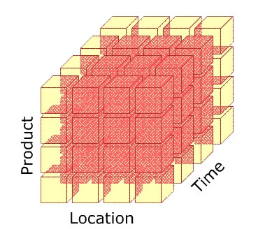
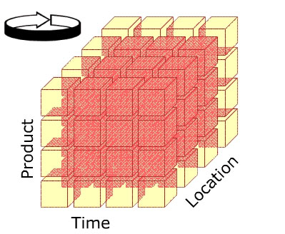
Data Warehouse stores data as Cubes
Data Warehouse Architectures
Data warehouses are the backbone of OLAP systems which are the engine that provides the answers to complex business queries
The databases that support OLAP must fulfill one important criteria → have high performance speeds for complex queries
ER Models cannot fulfill this criteria; they require a lot of JOINs and thus, slow down the speed of queries
Dimensional models are a better choice for OLAP because they use the denormalized form, and are structured in a way that models the business, instead of the data

Slide 18
Dimensional Modelling
Examples of ER and DM
To give a clearer picture of how Entity-Relation Models (ER) differ from Dimensional Models (DM), the next two slides present an example of the ER Model and the DM model respectively

Slide 19
Dimensional Modelling
A Transactional Database
Countries
Addresses
States
CountryID
AddressID
StateID
Description
Customers
StateID
CountryID
CustomerID
Street
Desc
AddressID
Name
OrderHeader
Products
OrderHeaderID
OrderDetails
ProductID
CustomerID
OrderHeaderID
Description
OrderDate
ProductID
Size
FreightAmount
Amount

Slide 20
Dimensional Modelling
A Dimensional Model
Customers
CustomerID
Time
Name
TimeID
Street
Date
FactSales
State
Month
CustomerID
Country
Quarter
ProductID
Year
TimeID
Products
SalesAmount
ProductID
Description
Size
Subcategory
Category

Slide 21
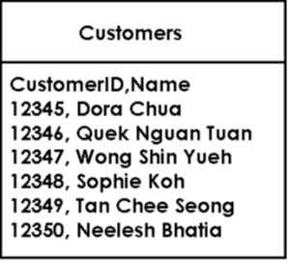
In the ER model, normalization reduces data redundancy. E.g. Customer 12346 bought four products, but his record only appears once in the Orders->Customers
How data is stored in a Relational Table

Slide 22
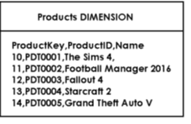
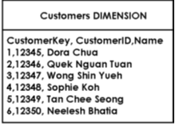
In the Dimensional mode, denormalization increases data redundancy. For instance, the Customer 12346 is repeated four times in the Sales Fact table
How data is stored in a Dimensional Table

Slide 23
What is a Dimensional Model?
Dimensional Modelling
A Dimensional Model is a database design intended to support end-user queries in a data warehouse
It is designed to be easily understood and for high query performance
Dimensional modelling uses the concepts of facts (measures) and dimensions (context)
A "fact" is a numeric value that a business wishes to count or sum.
A "dimension" describes facts. Dimensions are things of interest to the business

Slide 24
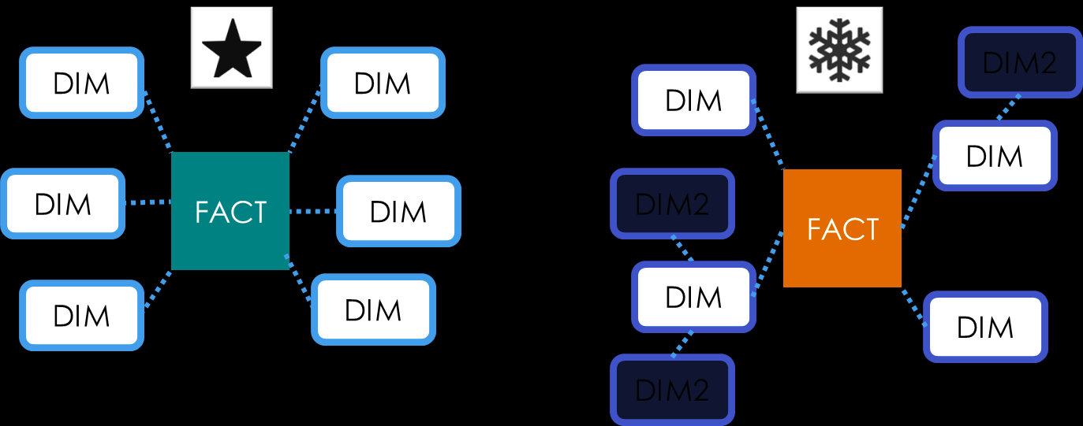
Facts and Dimensions
Dimensional Modelling
A dimensional model may be based on star schema or a snowflake schema.

Slide 25
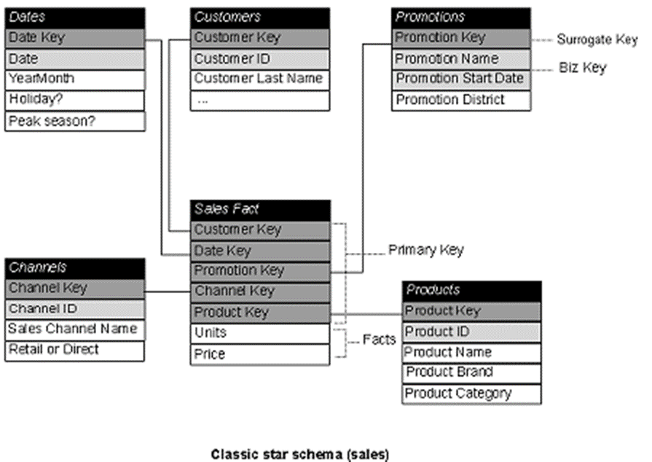
The Star Schema
Star Schema
The Star schema is a simple database design in which dimensional data are separated from fact or event data
A star schema consists of two types of tables: Fact tables and Dimension tables

Slide 26
Components of a Star Schema
Star Schema
Fact table A central table in a data warehouse / mart that describes a specific event such as product sale. Contains numerical values. Contains a number of facts
Fact A row in a table in a data warehouse / mart that contains primarily numeric values that measure a data event such as sales transaction.
Dimension A business entity such as customer and product.
Dimension table A table in a data warehouse / mart that describes business entity.

Slide 27
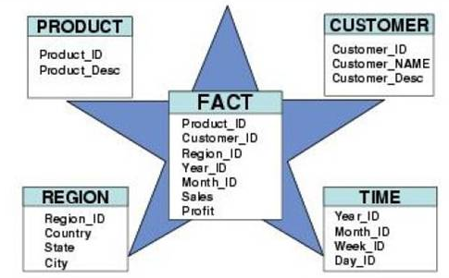
Characteristics of a Star Schema
Star Schema
A star schema is characterized as having a fact table in the centre and is surrounded by many dimension tables that contain de-normalized description of the facts
Benefits of a star schema
A star schema is a highly de-normalized set of tables -> query results come back faster as there would be less JOIN statements in SQL
It is able to perform dimensional analysis in a relational environment.

Slide 28
Components of a Star Schema
Star Schema
The Fact table store factual data and the Dimension tables store reference data
Each dimensional model is made up of at least one fact table with a multi-part key and a set of smaller tables called dimension tables
Each dimension table has a single-part primary key that corresponds exactly to one part of the multi-part key in the fact table.
A fact table can be extremely large relative to a dimension table

Slide 29
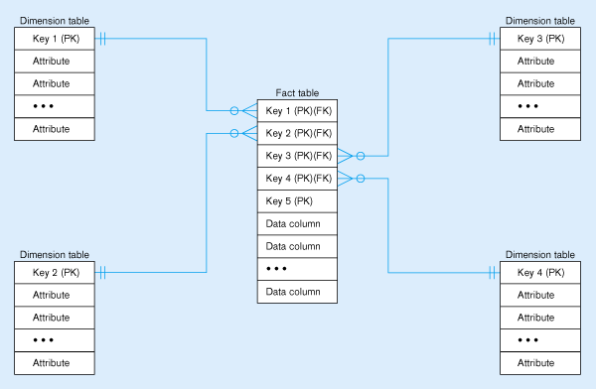
Fact Table and Dimension Tables
Star Schema
Fact tables contain factual or quantitative data
1:N relationship between dimension tables and fact tables
Dimension tables are denormalized to maximize performance
Dimension tables contain descriptions about the subjects of the business

Slide 30
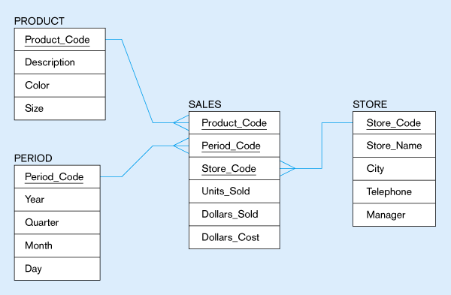
Example of a Star Schema
Star Schema

Slide 31
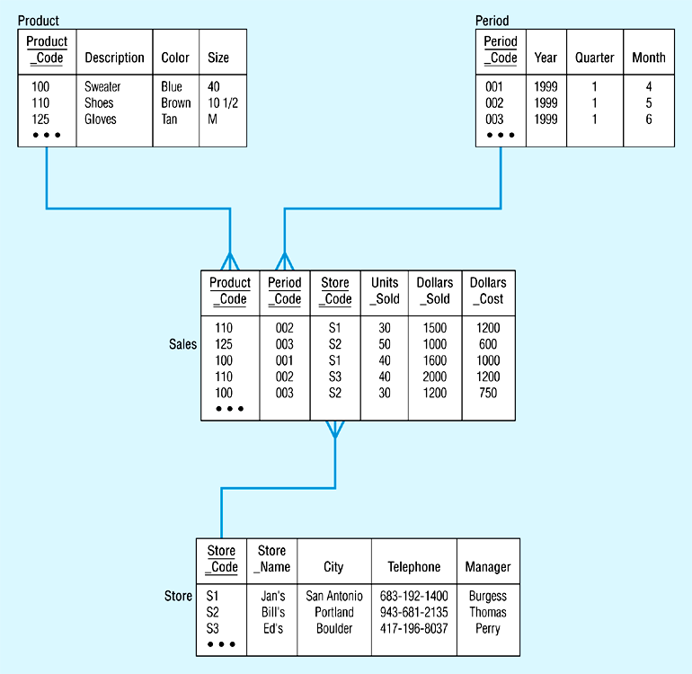
Star Schema with Data
Star Schema

Slide 32
Dimension Tables
Star Schema
Dimension tables has the following characteristics:
has one-to-many relationship to fact table
fewer rows than fact tables
primary key is single-part
contains primarily character data
contains multiple columns that are used to define dimensions hierarchies
structured to permit change

Slide 33
Fact tables
Star Schema
Fact table has the following characteristics:
has a many-to-one relationship to the dimension table
primary key is multi-part
has many more rows than those in the dimension tables
contains primarily numeric data (a.k.a measures) and very few character data

Slide 34
Multi-part Keys
Star Schema
Typically, multi-part keys function as the primary key for the fact table
The dimension keys of dimension tables are combined to form the multi-part primary key of the fact table
E.g. CustKey, ProductKey, SalesPersonKey, DateKey are used to form the multi-part primary key

Slide 35
The Snowflake Schema
Snowflake Schema
An expanded version of a star schema in which dimension tables are normalized into several related tables
Advantages | Disadvantages
Small savings in storage space Normalized structures are easier to maintain and update | Schema is less intuitive More difficult to browse through the content Degraded query performance because of additional JOINs

Slide 36
Characteristics of Snowflake Schema
Snowflake Schema
Result of either business environment or third-party application or design which cannot be implemented by a star schema
Dimension tables are of two types: primary and secondary
Primary dimension tables are joined to the fact table
Secondary dimension tables are joined to the primary dimension tables
It can increase query performance if the users are accessing data stored in the primary dimension tables 80% of the time
Snowflake schema may need a number of joins to apply a specific textual constraint to a query

Slide 37
Example of snowflake schema
Snowflake Schema
time
time_key
day
day_of_the_week
month
quarter
year
item
item_key
item_name
brand
type
supplier_key
supplier
Sales Fact Table
supplier_key
supplier_type
time_key
item_key
branch_key
branch
location
location_key
location_key
street
city_key
branch_key
branch_name
branch_type
units_sold
city
dollars_sold
city_key
city
province_or_street
country
avg_sales
Measures

Slide 38
Compare Star schema & Snowflake schema
Snowflake Schema
 | Star schema | Snowflake Schema
How easy it is to understand the model | Easier | More difficult
Number of tables | Few | More
Query Complexity | Easy to construct as there are less tables and hence fewer joins are required | More complex because there are more tables and hence more joins are required
Query Performance | Quicker to access textual values because of fewer joins | Slower to access textual values because of more joins

Slide 39
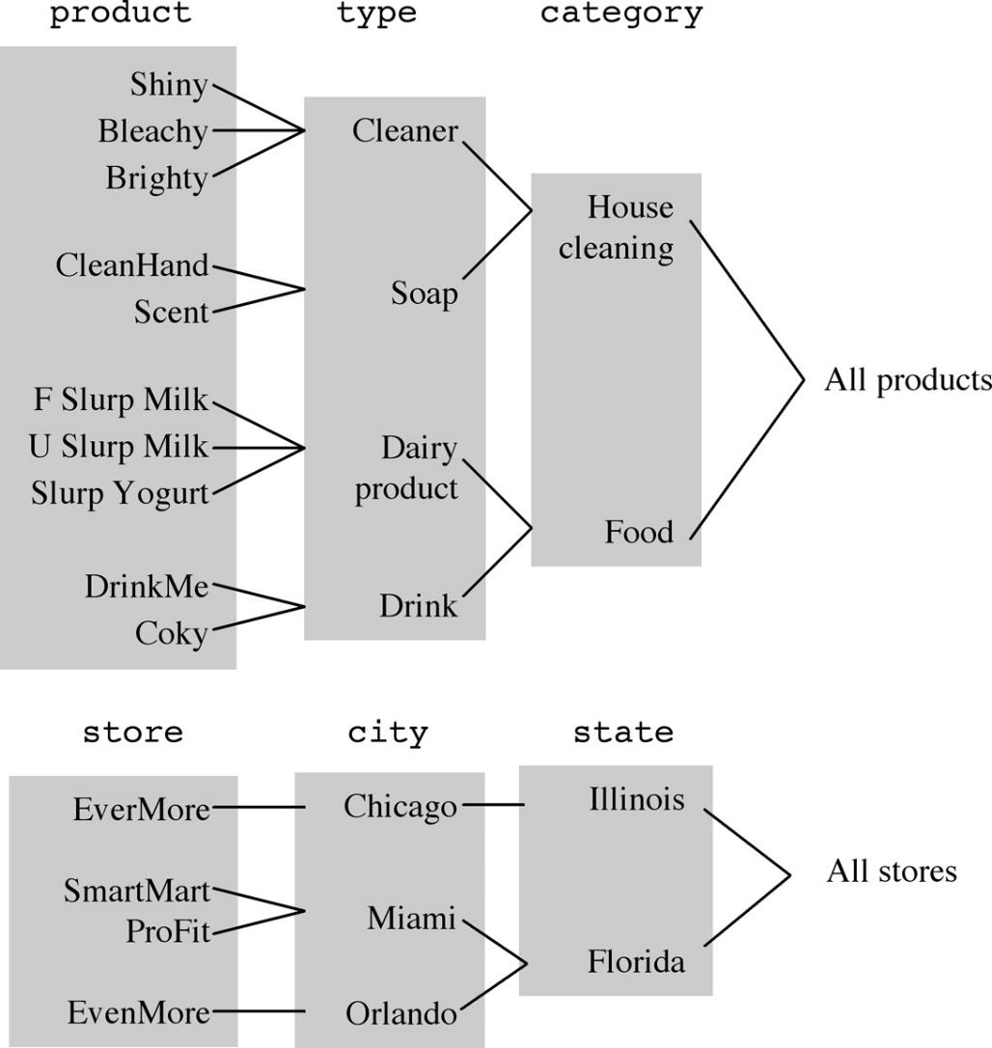
Dimension Hierarchies
Star Schema
A useful feature you can build into a Star or Snowflake dimensional model is the “Hierarchy” component
A hierarchy is a logical structure that uses ordered levels to aggregate data (consolidate related data under one group)
E.g. in a Time dimension, a hierarchy can be used to aggregate data from the Month level to the Quarter level, from the Quarter level to the Year level
E.g. In a Product dimension, a hierarchy might be used to aggregate data from the Model level to the Brand level, from the Brand level to the Category level

Slide 40
Steps in designing a Star Schema
Designing Dimensional Model
Choose a business process to model, e.g. Sales
Choose the grain (lowest level of summary) of the Fact table
Identify the measures or facts (e.g. Sales Total)
Identify the dimensions for each fact record (E.g. Product dimension, Location dimension, Time dimension, Customer dimension)
List the columns that describe each dimension (E.g. product name,, product brand, product category)
Notes:
http://sqlmag.com/database-administration/step-step-data-warehousing

Slide 41
Grain
Designing Dimensional Model
The grain of the dimensional model is the finest level of detail that is implied when the fact and dimension tables are joined
Example 1: the granularity of a dimensional model that consists of the dimensions Date, Store, and Product is the product sold in store by day
Example 2: the granularity of a dimensional model that consists of the dimensions Date, Store, Customer and Product is the customer that a product was sold to in a store on a particular day
If more details are included, the level of granularity is lower
If less detail is included, the level of granularity is higher
Notes:
http://www-01.ibm.com/support/knowledgecenter/SS9UM9_8.5.0/com.ibm.datatools.dimensional.ui.doc/topics/c_dm_design_cycle_2_idgrain.dita?lang=en

Slide 42
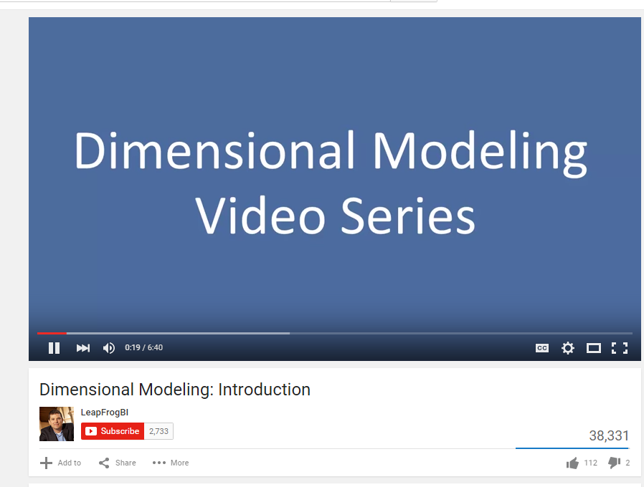
Dimensional Modelling - Intro
Videos
https://www.youtube.com/watch?v=cwpL-3rkRYQ

Slide 43
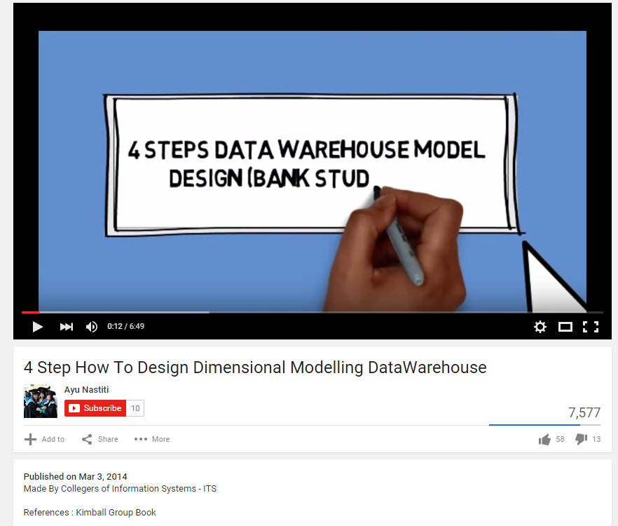
4 Steps – Design Dimensional Models
Videos
https://www.youtube.com/watch?v=dqMarPAUYho

Slide 44
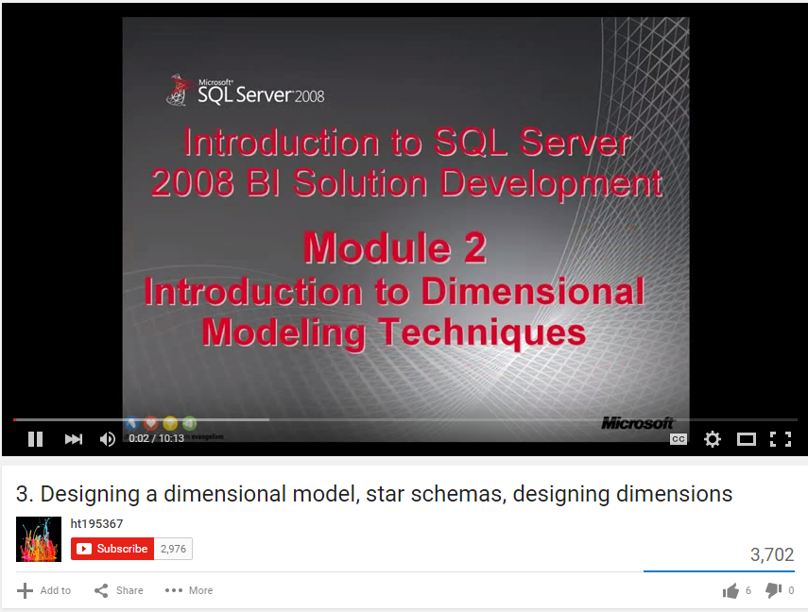
Dimensional Modelling
Videos
https://www.youtube.com/watch?v=aFoOmv8olJk

Slide 45
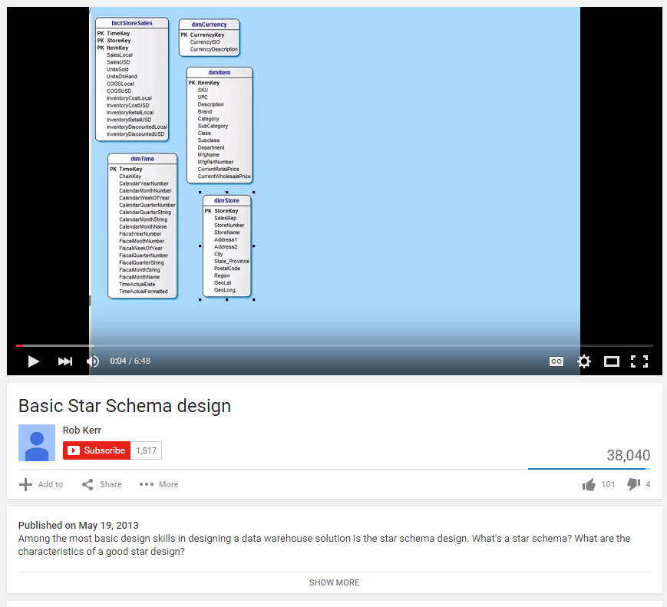
Basic Star Schema Design
Videos
https://www.youtube.com/watch?v=q77B-G8CA24

